Slide 1
New York Culinary Medicine presents:
Busting Common Food Myths
… from a nephrological perspective
Dara Huang, MD
Notes:
debunks common food myths

Slide 2
What do the kidneys do?
...and how is it related to my diet?

Slide 3
Important roles of the Kidney:
#1 Water balance - prevents dehydration
#2 Salt balance - controls blood pressure
#3 Electrolyte balance - regulates body chemistry
#4 Makes RBC hormone - prevents anemia
#5 Activates Vitamin D - maintains bone health
Notes:
kidneys process about 48 gallons (200 quarts) of blood every day to sift out about 2 quarts of waste products and extra water. The waste and extra water become urine,the tubules receive a combination of waste materials and chemicals that your body can still use. Your kidneys measure out chemicals like sodium, phosphorus, and potassium and release them back to the blood to return to the body. In this way, your kidneys regulate the body's level of these substances. The right balance is necessary for life, but excess levels can be harmful. In addition to removing wastes, your kidneys release three important hormones:
Erythropoietin or EPO, which stimulates the bones to make red blood cells.
Renin which regulates blood pressure.
The active form of vitamin D, which helps maintain calcium for bones and for normal chemical balance in the body.

Slide 4
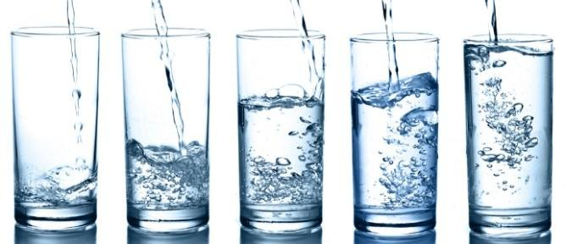
#1 True or False:
Drink 8 glasses of water a day
Notes:
Prevention of kidney disease request specific guidelines for water intake and query on the amount of water intake needed to
“flush” out toxins in the kidney. The “urban myth” of eight 8-ounce glasses of water (a half gallon or 1.9 L) per day

Slide 5
FALSE!

Slide 6
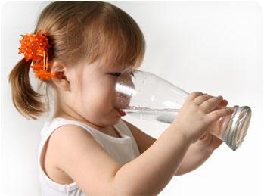
FACT:
Some people need to limit their fluids while others can drink any amount they wish otherwise they feel thirsty.
As kidney function decreases, the kidneys may not produce as much as urine as before & your body may become overloaded with fluid.

Slide 7
Kidneys control water balance
Normal Na range: 135-145 meq/L
Harmful if: Too much water (hyponatremia)
< 135 - mild hypoNa
Nausea, malaise, headache
<125 - severe hypoNa
Lethargy, decreased consciousness, seizures, coma
Notes:
nausea and malaise, with mild reduction in the serum sodium, to lethargy, decreased level of consciousness, headache, and (if severe) seizures and coma. Overt neurologic symptoms most often are due to very low serum sodium levels (usually < 115 mEq/L), resulting in intracerebral osmotic fluid shifts and brain edema. This neurologic symptom complex can lead to tentorial herniation with subsequent brain stem compression and respiratory arrest,

Slide 8
So how much should you drink?
Minimum daily water losses are 500 ml through the urine and 700 mL through breathing and sweat.
THUS: Drink at least 1.2 liters of liquids (2.5 pints)
So remember, although water is essential, you don’t have to become obsessed about drinking 8 glasses (4 pints) a day! Best to: let thirst mechanism kick in!
Notes:
On average, your body loses 1 to 1.5 litres of water a day. If someone is undertaking a lot of activity, and therefore breathing and sweating more, they would lose more.
It is not essential to always drink a set amount regardless of circumstances. The body is very good at regulating water.
If you drink too much, your body will get rid of the excess, so you will pass urine more often and it will look almost clear.
'If you don't drink enough, your body will save water by concentrating your urine, which will look darker, and your brain will tell you that you need more water by making you feel thirsty.'
Another thing to keep in mind is that water is found in fruits, vegetables, milk and juices. Water from these sources will go some way to meeting your daily requirements, so people do not need to drink a full eight glasses of water on top of this

Slide 9
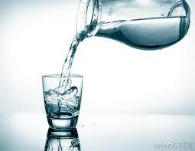
Exception to the water rule:
Those with kidney stones or UTI (with normal kidney function) need to drink more water.
More urine production prevents stone -causing minerals to settle and bond in the kidneys and urinary tract.
Notes:
Don't Underestimate Your Sweat. Saunas, hot yoga and heavy exercise may be good for your health, but they also may lead to kidney stones. Why? Loss of water through sweating - whether due to these activities or just the heat of summer—leads to less urine production. The more you sweat, the less you urinate, which allows for stone-causing minerals to settle and bond in the kidneys and urinary tract

Slide 10
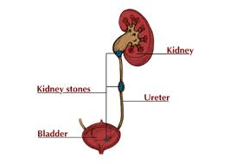
Next: Kidney stones
Kidney stones can form when substances in the urine—such as calcium, oxalate, and phosphorus—become highly concentrated.
These substances form crystals that gradually increase in size and can become stuck within the kidney or urinary tract.
>80% stones are made of calcium (calcium oxalate, calcium phosphate)
Diet is one of several factors that can promote or inhibit kidney stone formation.
Notes:
Stones form when minerals, such as calcium, are present in the urine at abnormally high levels.

Slide 11
#2 True or False
More calcium = kidney stones
Notes:
"I've even had patients say that their doctors told them to reduce their calcium intake."

Slide 12
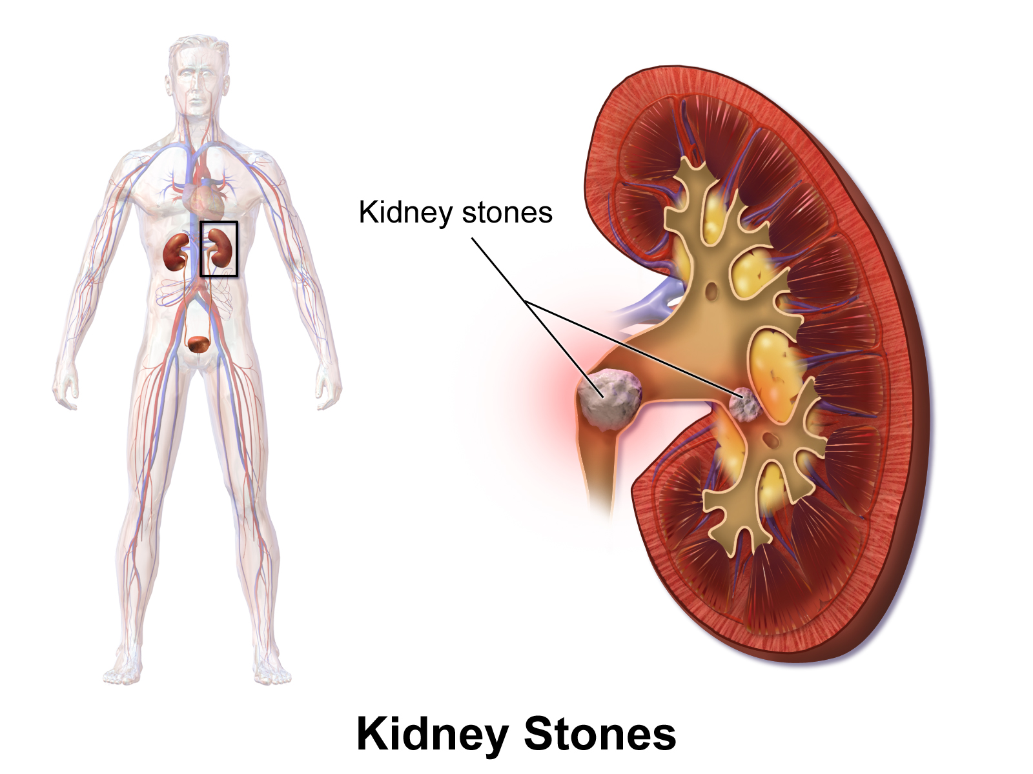
FALSE!
Notes:
Four major types of kidney stones can form: calcium stones, uric acid stones, struvite stones, and cystine stones.

Slide 13
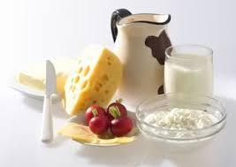
FACT: Calcium is not the enemy
A low calcium diet can actually increase one's risk of developing kidney stones.
Calcium from food does not increase the risk of calcium oxalate stones. Calcium in the digestive tract binds to oxalate from food and keeps it from entering the blood, and then to the kidneys where it can form stones.
Instead: Don't reduce the calcium. Work to cut back on the sodium in your diet and to combine calcium-rich foods with oxalate-rich foods.
Notes:
.A common misconception is that calcium is the main culprit in calcium-oxalate stones. But actually, stones may recur despite cutting down on their calcium intake

Slide 14
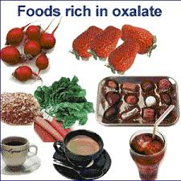
Neither is oxalate...
Oxalate is naturally found in many foods, including fruits and vegetables, nuts and seeds, grains, legumes, chocolate and tea.
Foods containing high levels of oxalate include: peanuts, rhubarb, spinach, beets, strawberries and sweet potatoes.
A common food myth is that cutting the oxalate-rich foods in your diet alone will reduce the likelihood of forming calcium oxalate kidney stones.
Instead: Eat and drink calcium and oxalate-rich foods together during a meal. Oxalate and calcium are more likely to bind together in the stomach before it reaches the kidneys, making it less likely for stones to form.
Notes:
Oxalate–rich foods may contribute to the formation of kidney stones. Patients avoiding foods high in oxalate, including rhubarb, spinach, strawberries, chocolate (especially dark), wheat bran, nuts, beets, and tea.

Slide 15
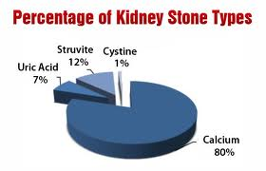
Why is knowing what type of stone important?
First step in preventing kidney stones is to know what is causing the stones to form.
Different types of stones may have different diet recommendations and medications used for prevention.
For example, limiting oxalate may help prevent calcium oxalate stones but won’t prevent uric acid stones.

Slide 16
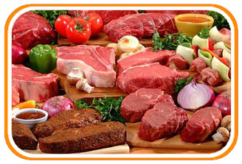
Not all stones are created equal
Uric acid stones form when the urine is persistently acidic. A diet rich in purines—substances found in animal protein such as meats, fish, and shellfish—may increase uric acid in urine. If uric acid becomes concentrated in the urine, it can settle and form a stone by itself or along with calcium.
Instead: Cut down on high-purine foods including meats and seafood. Organ meats such as liver, tongue, and sweetbreads, anchovies, sardines, bacon, beef and seafood such as lobster and shrimp, cauliflower, codfish, ham, veal and venison.
Notes:
Meats and other animal protein—such as eggs and fish—contain purines, which break down into uric acid in the urine

Slide 17
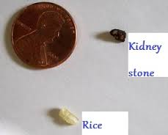
It’s not one and done..
Passing a kidney stone is not always a one-time event. Studies have shown that having even one stone greatly increases your chances of having another.
15% of kidney stone patients didn't take prescribed medications and 41% did not follow the nutritional advice that would keep stones from recurring.

Slide 18
In general, how do I prevent kidney stones?
Drink more water! Drinking enough fluid is the most important thing a person can do to prevent kidney stones.
People who have had a kidney stone should drink enough water and other fluids to make at least 2 liters of urine a day.
Sodium, often from salt, causes the kidneys to excrete more calcium into the urine. High concentrations of calcium in the urine combine with oxalate and phosphorus to form stones. Reducing sodium intake is preferred to reducing calcium intake.
Notes:
For all types of stones: One of the best measures you can take to avoid kidney stones is to drink plenty of water, leading you to urinate a lot. So, be sure to keep well hydrated, especially when engaging in exercise or activities that cause a lot of sweating.

Slide 19
#3 True or False?
Adding table salt will cause high blood pressure
and should be avoided.
Notes:
DASH eating plan is rich in fruits, vegetables, fat-free or low-fat milk and milk products, whole grains, fish, poultry, beans, seeds, and nuts. It also contains less salt and sodium; sweets, added sugars, and sugar–containing beverages; fats, and red meats, than the typical American diet. This heart-healthy approach to eating minimizes saturated fat, trans fat, and cholesterol and stresses nutrients which are associated with lowering blood pressure—mainly potassium, magnesium, and calcium, protein, and fiber.”
Heart disease and kidney disease are linked, so having one predisposes you to the other. High blood pressure is common to both heart disease and kidney disease and the most common cause of death in kidney patients is heart disease. Therefore, adopting the DASH diet is a recognized treatment of hypertension, heart disease, and kidney disease. The DASH diet can slow the progression of both heart disease and kidney disease.

Slide 20
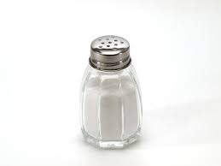
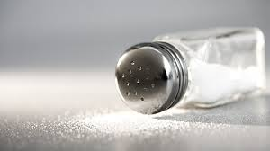
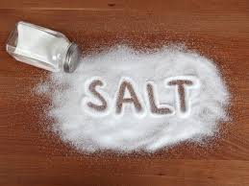
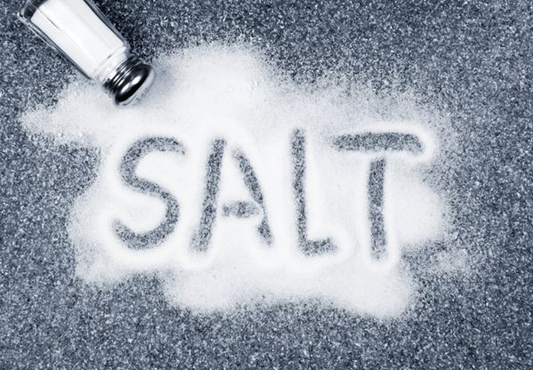
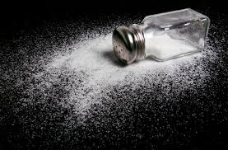
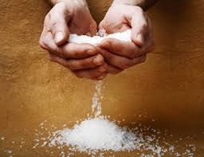
FALSE!

Slide 21
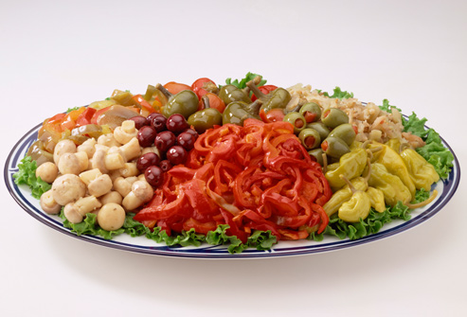
Fact:
Only 5% of the sodium in the American diet comes from
salt added at the table
5% comes from salt added during cooking
70-80% of the sodium comes from packaged, processed, restaurant and store-bought foods.
Notes:
Salty Toppings
Processed artichoke hearts, chickpeas, and olives are just a few of the salt shockers lurking on the salad bar. To avoid getting too much sodium, limit anything that comes out of a can. Also pass up cured meats. Choose beans or tuna, but not both.

Slide 22
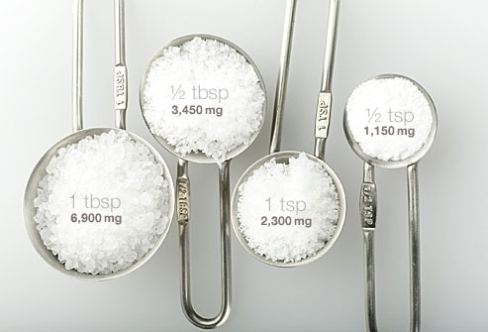
How much salt should I eat?
Average American eats 3.5 g of sodium per day (½ Tbsp)
Maximum recommendation of 2.3 g
(1 tsp)
But if you are older than 51; African-American; or have high blood pressure, diabetes, or chronic kidney disease, recommend <1.5g per day
(½ tsp)
Notes:
The average American takes in 3,400 milligrams of sodium each day, well above the limits recommended for good health

Slide 23
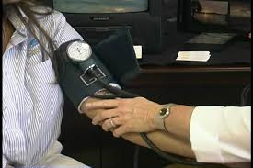
What is my target blood pressure?
General population <60 yo:
Goal bp <140/90
>60 yo
Goal bp <150/90
HYVET trial
- Evaluated the benefits and risks of providing medical care to very elderly individuals presenting with hypertension
Lowering bp prevents vascular events such as stroke
There has been no conclusive results suggesting benefit in treating patients with hypertension over 80 years of age
Notes:
In the general population ages 60 and older, pharmacologic treatment to lower BP should be initiated at a systolic blood pressure (SBP) of 150 mmHg or higher or a diastolic blood pressure (DBP) of 90 mmHg or higher. Patients should be treated to a goal SBP lower than 150 mmHg and a goal DBP lower than 90 mmHg.
In the general population younger than age 60, initiate pharmacologic treatment at a DBP of 90 mmHg or higher or an SBP of 140 mmHg or higher and treat to goals below these respective thresholds.

Slide 24
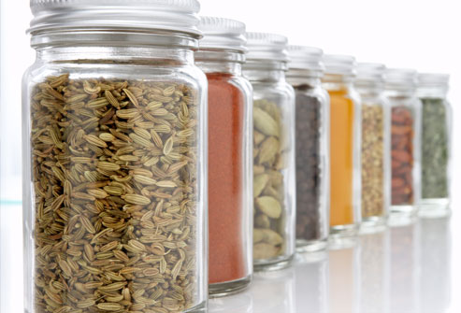
What can I do to lower my salt intake?
Go easy on high sodium condiments like mustard, ketchup and soy sauce
Drain or rinse canned /processed foods
Use herbs, citrus and salt-free spices to season dishes.
Ask for salt-free or low salt preparation in restaurants
Know your food labels
LESS sodium is not LOW sodium
Notes:
Reduce your use of processed foods with high sodium content on their labels. These include frozen dinners, canned foods, commercial sauces and dressings, and snack foods. Instead, buy foods that say "No salt added" or "Very Low sodium" on the label.
Rinse canned beans and vegetables that have added salt to remove as much additional sodium as possible.
4. Reduce the amount of sodium in canned foods by thoroughly draining and rinsing them.
Add a dash of lemon or vinegar to your foods. Increasing the sourness of a dish is a way to appease your salty taste buds.
1. Read nutrition labels on foods you purchase to see how much sodium they contain.
3. Eat more fresh, unprocessed foods, like fruits and vegetables, which are naturally low in sodium.

Slide 25
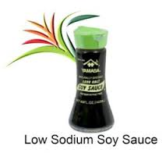
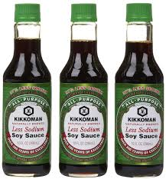
Learning the Lingo
Reduced/ Less sodium = 25% less than regular version
Low sodium < 140 mg per serving
Very low sodium < 35 mg
Sodium free or salt free < 5 mg
Unsalted / no added salt = None
Notes:
The Food and Drug Administration has regulations as to what is considered a high- and low-sodium food:

Slide 26
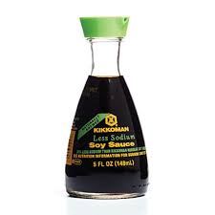
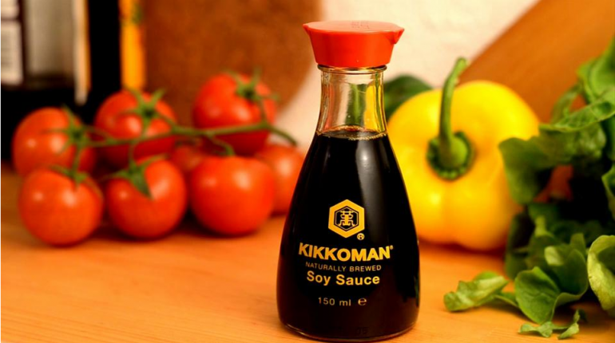
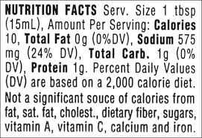
1 Tbsp = 920 mg sodium (38% RDA)
Notes:
1 tablespoon of Kikkoman soy sauce has 920 mg of sodium. 38% of your recommended daily allowance of sodium
575 mg of sodium (24% of your RDA)

Slide 27
Have you ever felt?
More tired than usual, fatigued
Feel weak
Have pale skin, brittle nails,
Feel “down” or depressed
Feel short of breath with activity
Have chest pain
Feel dizzy or light-headed
Feel numbness or coldness in your hands and feet
Have a faster heartbeat

Slide 28
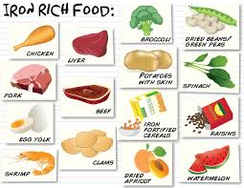
Iron deficiency
Iron is an essential component of the pigment hemoglobin, found in red blood cells. It helps carry oxygen to all parts of the body and is essential. If iron intake is low, the amount of hemoglobin in the red blood cells can fall leading to iron-deficiency anemia.

Slide 29
#4 True or False?
Red meat is the best source for iron and treating anemia
Notes:
One of the commonest food myths is that vegetarians and vegans have a higher risk of iron deficiency anaemia because they don't eat meat..

Slide 30
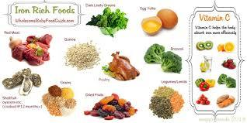
FALSE!

Slide 31
FACT:
> 75% of iron in the diet comes from plant-based foods
Healthy sources of iron include greens and legumes. Although the myth persists that meat is a preferred iron source, a balanced vegetarian diet that includes legumes, fortified grains, and green vegetables easily provides adequate iron.
Studies have shown that iron deficiency anemia is not greater among individuals consuming a healthy vegetarian diet than among omnivores.

Slide 32
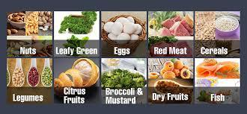
Iron Deficiency Anemia
Dietary iron is available in 2 forms: heme and nonheme.
Heme iron is found in animal muscle and blood, is absorbed at a relatively constant rate of about 23%, independent of other dietary factors.
Nonheme iron is found both in animal products and in a variety of plant-based foods. Nonheme iron absorption varies, depending on other dietary factors

Slide 33
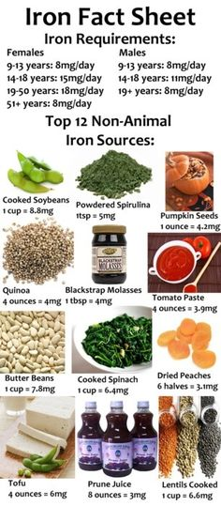
Good sources of iron include:
Legumes (peas, beans and lentils)
Soy bean products (soy milk and tofu)
Dark green leafy vegetables (parsley, broccoli, bok choy and watercress)
Fortified breakfast cereals
Whole grains (wholemeal bread, wholemeal pasta)
Dried fruits (raisins, prunes, apricots and figs)
Plain dark chocolate

Slide 34
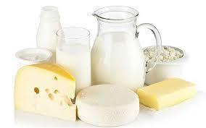
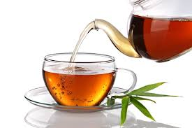
Foods that decrease iron absorption:
Dairy products and eggs
Caseins from milk and certain forms of calcium inhibit iron absorption. Eggs (especially yolks) also appear to inhibit iron absorption.
Tea, esp black tea, coffee, and cocoa should not be consumed with meals if poor iron status is suspected. Polyphenols in these drinks inhibit the absorption of nonheme iron

Slide 35
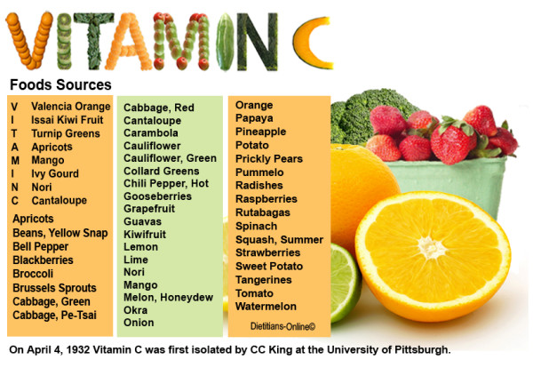
Foods that increase iron absorption:
Fruits and vegetables contain vitamin C and organic acids (eg, citric acid) allows for better absorption of nonheme iron.
Vitamin A and carotenoids also aids in better iron absorption and has been shown to result in less anemia than taking iron supplement alone

Slide 36
But Wait!

Slide 37
Not all Anemia is due to lack of dietary iron..
Iron deficiency anemia - Blood loss, iron deficiency
Vitamin deficiency anemias - Folate/ Vitamin B-12 deficiency
Anemia of chronic disease - Certain chronic diseases (cancer, HIV/AIDS, rheumatoid arthritis, Crohn's disease) can interfere with the production of red blood cells, resulting in chronic anemia.
Kidney failure also can cause anemia because it makes erythropoetin (EPO)
Anemias associated with bone marrow disease
Hemolytic anemias

Slide 38
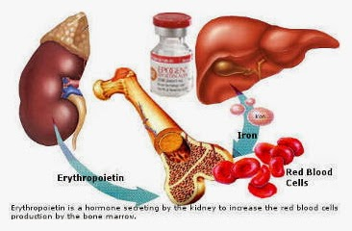
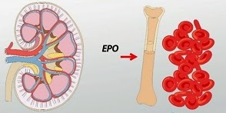
Anemia of Chronic Kidney Disease
Erythropoetin is a hormone secreted by the kidney to increase the RBC production in the bone marrow
Notes:
Kidneys make a hormone called erythropoeitin (EPO) that signals body to make RBC. if you have kidney disease, may not be able to make Epo, causing anemia, and need Iron supllements/ also epo shot.
Anemia is common in kidney disease patients. In patients with iron deficiency, supplemental iron should be used. Patients with advanced kidney disease are usually treated with a medication called erythropoietin

Slide 39
#5 True or False?
All Vitamin D supplements are all the same

Slide 40
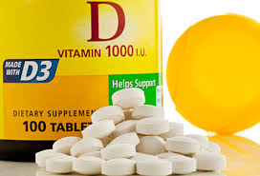
FALSE!

Slide 41
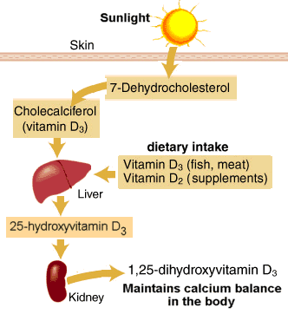
Notes:
(1α hydroxylase)

Slide 42
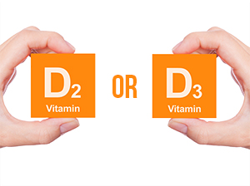
Vitamin D3 vs D2
Vitamin D3 has a longer half-life compared to D2.
D3 is more readily converted to the active form of vitamin D, 1,25(OH)D.
The active form of D3 is more potent than D2; after conversion to the 1,25 form, some 1,25(OH)D2 is partially deactivated in the kidney, whereas 1,25(OH)D3 remains active.
Thus, starting with the same dose of D2 and D3, taking D3 would produce more active vitamin D in the body.

Slide 43
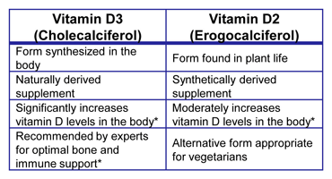
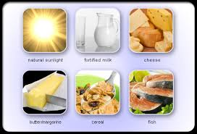
Notes:
There are two forms of vitamin D available in supplemental form: vitamin D2 (ergocalciferol) and vitamin D3 (cholecalciferol). D3 is the form that is produced in our skin when we are exposed to sunlight.

Slide 44
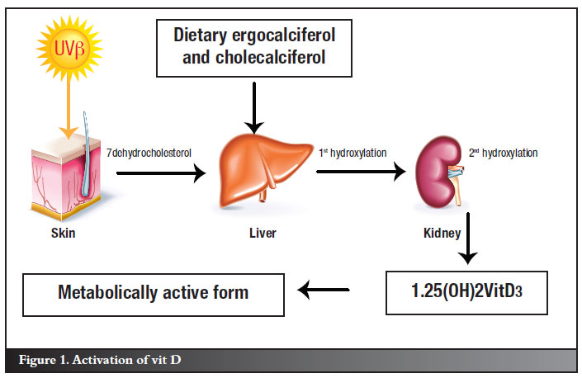

Slide 45
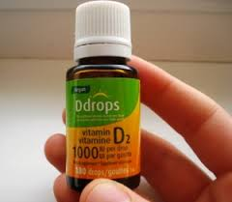
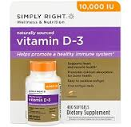
25 Vitamin D
Vitamin D2 = ergocalciferol
Vitamin D3 = cholecalciferol
1,25 Vitamin D = calcitriol
deficiency in kidney disease
Notes:
Although there are differences among vitamin D methods, most laboratories utilize similar reference intervals. Because toxicity is rare, the focus has been on the lower limit and what cut-off for total 25-hydroxyvitamin D (D2 + D3) indicates deficiency.
The Endocrine Society defines vitamin D deficiency as a 25-hydroxyvitamin D blood level below 20 ng/mL (50 nmol/liter) and vitamin D insufficiency as a level between 21–29 ng/mL (52.5–72.5 nmol/liter).
The U.S. Institute of Medicine has concluded that a 25-hydroxyvitamin D level of 20 ng/mL (50 nmol/liter) or above is adequate for bone health, and that levels greater than 30 ng/mL do not offer significantly better effects. However, it is fair to say that the level of 25-hydroxyvitamin D associated with protection from the many other disorders recently associated with a lack of vitamin D is controversial.
25-hydroxyvitamin D
A low blood level of 25-hydroxyvitamin D may mean that a person is not getting enough exposure to sunlight or enough dietary vitamin D to meet his or her body's demand or that there is a problem with its absorption from the intestines. Occasionally, drugs used to treat seizures, particularly phenytoin (Dilantin), can interfere with the production of 25-hydroxyvitamin D in the liver.
There is some evidence that vitamin D deficiency may increase the risk of some cancers, immune diseases, andcardiovascular disease.
A high level of 25-hydroxyvitamin D usually reflects excess supplementation from vitamin pills or other nutritional supplements.
1,25-dihydroxyvitamin D
A low level of 1,25-dihydroxyvitamin D can be seen in kidney disease and is one of the earliest changes to occur in persons with early kidney failure.

Slide 46
Busting Common Food Myths
#1 Drinking 8 glasses of water a day
#2 Avoid calcium to prevent kidney stones
#3 Adding table salt to food is the cause for hypertension
#4 Eating red meat is the only way to treat anemia
#5 Vitamin D supplements are all the same

Slide 47
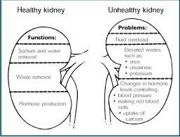
What happens if the kidneys fail?
#1 Water imbalance
#2 Fluid overload: Hypertension, CHF, Edema
#3 Electrolyte abnormalities
#4 Anemia of chronic kidney disease
#5 Osteopenia/ Osteoporosis

Slide 48
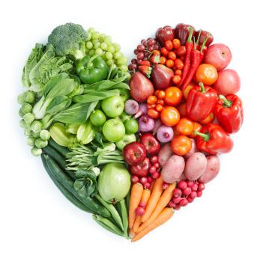
So, mind your kidneys and eat smart!
Thank you!

